Slide 1
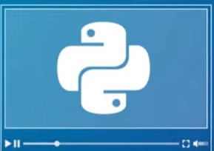
COSC 1336 Fundamentals of Programming
Python - Introduction

Slide 2
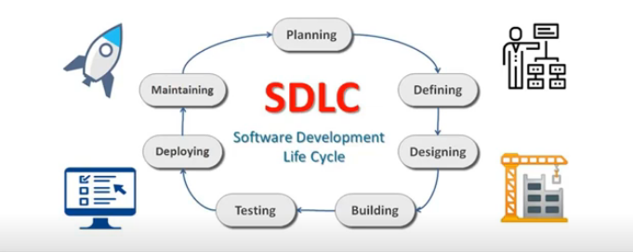
How Software is Developed

Slide 3
SDLC
The software development project typically involves many activities and goes through different development of stages.
These stages in the development are also referred as software development life cycle phases.

Slide 4
SDLC – Software Planning Phase
The project planning is the most important step.
It helps the software design team to plan for all the resources required to complete the project within stipulated time and resources.
During the planning stage, the software development team has to plan various activities, manpower resources, infrastructure required and other resources required to complete the project. A feasibility study is performed.

Slide 5
SDLC – Software Defining Phase
In the requirement elicitation process, the software development team extensively interact with all the stake holders to capture and map all the information necessary for defining the Software Requirement Specifications (SRS).
The software developer must document, this important piece of information, which is part of the agreement, with the client company. After the project completion, the software performance is assessed against the S R S And agreed design objectives.

Slide 6
SDLC – Software Designing Phase
The software designing phase includes, finalizing the various design features, in terms of both software requirements, and the supporting hardware requirements. The software architects, and the software developers explore the various alternative approaches, and finally, propose the product solutions.
The software developer, design the software system, and specify the technology, to develop the software system,. The software architect, document this information about the product architecture in the Design Document Specifications (DDS).

Slide 7
SDLC – Software Building Phase
Depending upon the type of the software, that is being developed, the software development team, can select the technology to be used, for the development of the software.
The software development team, can select the suitable platform, programming language, software framework, database management system, and other building tools, as specified, in the software system architecture.
The Software building activities includes Coding the varies modules, debugging the program code, compiling the various software components and testing the functionally.

Slide 8
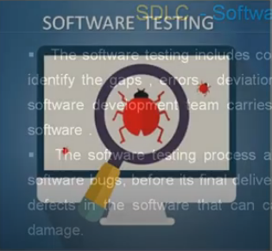
SDLC – Software Testing Phase
Once the software coding task is completed and the final software product is ready for deployment, the software is subjected to rigorous and extensive testing before the final deployment and the delivery to the client.
The software testing is the standard process used in the software industry to test the software for the performance, accuracy of results and user experience to ensure the satisfaction of the use expectations.
USE case is used in testing.
UAT is required.

Slide 9
SDLC – Software Deployment & Delivery Phase
The software is considered to be ready for deployment after building the software and it has successfully gone trough all the tests to ensure the bug free software and the product that meets all the quality parameters.
After its successful installation, the next task is to impact training to the end user. The software has to successfully complete the user acceptance trials and the software must achieve the design objectives.

Slide 10
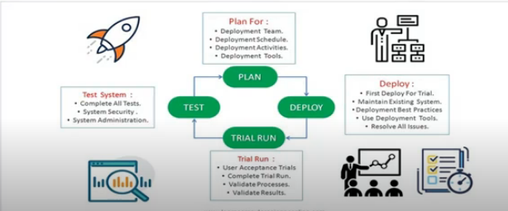
SDLC – Software Deployment & Delivery Phase

Slide 11
SDLC – Software Maintenance Phase
The software maintenance phase of the SDLC starts after the software deployment process is completed and the software is fully operational.
The software maintenance tasks include number of activities such as periodic software upgrades, software patches, database clan up operations, and resoling any other issues.

Slide 12
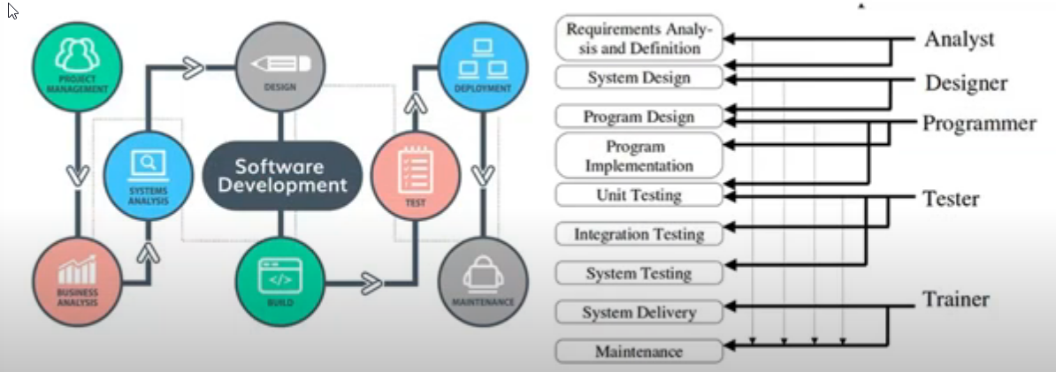
SDLC Phases

Slide 13
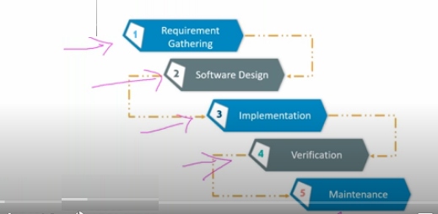
SDLC – Waterfall Method

Slide 14
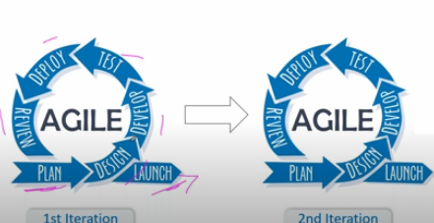
SDLC – Agile Method

Slide 15
SDLC – Software Building Phase
What is difference between
Programming
And
Coding
?

Slide 16
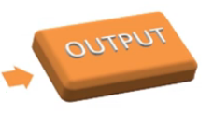
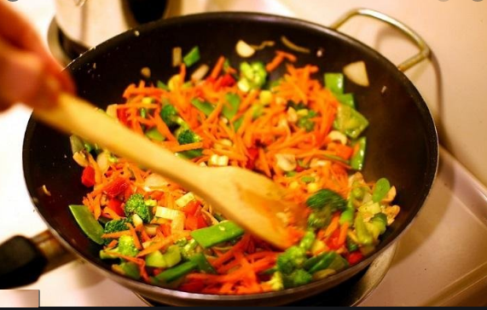
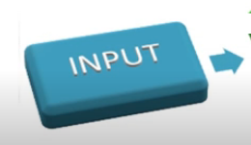
Coding == Cooking
Container
Variable
Not enough salt
IF Logic
Stir
Loop Logic

Slide 17
Steps to Coding
Create a conceptual STEP by STEP workflow!
Just like a RECIPE
Computing Weekly Pay

Slide 18
Steps to Coding - Pseudocode
Computing Weekly Pay
get hours worked
get hourly pay rate
Gross pay = hours worked times hourly pay rate
display Gross pay
halt

Slide 19
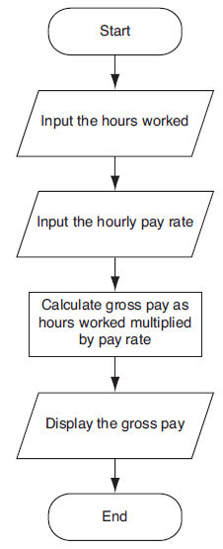
Steps to Coding – Flow Chart
Computing Weekly Pay
Ovals - terminal symbols
Parallelograms – I/O
Rectangles - processing
Arrows - the process flow

Slide 20
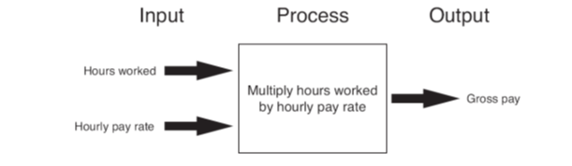
Steps to Coding – IPO
Computing Weekly Pay

Slide 21
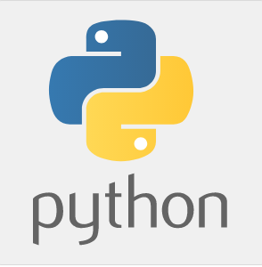
Coding Language

Slide 22
Python
Python is designed to be highly readable.
It uses English keywords frequently where as other languages use punctuation.
It has fewer syntactical constructions than other languages.

Slide 23
Python
Python was developed by Guido van Rossum in the late eighties and early nineties at the National Research Institute for Mathematics and Computer Science in the Netherlands.
Python is derived from many other languages, including ABC, Modula-3, C, C++, Algol-68, SmallTalk, and Unix shell and other scripting languages.
Python is copyrighted. Like Perl, Python source code is now available under the GNU General Public License (GPL).
Python is now maintained by a core development team at the institute, although Guido van Rossum still holds a vital role in directing its progress.

Slide 24
Python
Easy-to-learn
Easy-to-read
Easy-to-maintain
A broad standard library
Interactive Mode
Python has few keywords, simple structure, and a clearly defined syntax.
This allows the student to pick up the language quickly.
Python code is more clearly defined and visible to the eyes.
Python's source code is fairly easy-to-maintain.
Python's bulk of the library is very portable and cross-platform compatible on UNIX, Windows, and Macintosh.
Python has support for an interactive mode which allows interactive testing and debugging of snippets of code.

Slide 25
Python
Portable
Extendable
Databases
GUI Programming
Scalable
Python can run on a wide variety of hardware platforms and has the same interface on all platforms.
You can add low-level modules to the Python interpreter.
These modules enable programmers to add to or customize their tools to be more efficient.
Python provides interfaces to all major commercial databases.
Python supports GUI applications that can be created and ported to many system calls, libraries and windows systems, such as Windows MFC, Macintosh, and the X Window system of Unix.
Python provides a better structure and support for large programs than shell scripting.

Slide 26
Python
It supports functional and structured programming methods as well as OOP.
It can be used as a scripting language or can be compiled to byte-code for building large applications.
It provides very high-level dynamic data types and supports dynamic type checking.
It supports automatic garbage collection.
It can be easily integrated with C, C++, COM, ActiveX, CORBA, and Java.

Slide 27
Python - Identifier
Identifier
a name used to identify a variable, function, class, module or other object.

Slide 28
Python - Identifier
Rules
Starts with a letter A to Z or a to z or an underscore (_) followed by zero or more letters, underscores and digits (0 to 9).
Cannot use a space, period (.), exclamation mark (!), or the special characters @, &, $, # in the name.
Cannot exceed 255 characters in length.
Case sensitive programming language.
Manpower and manpower are two different identifiers.
Identifier name cannot be a Python key word.
Identifier name cannot contain spaces
Suggestion: Variable name should reflect its use

Slide 29
Python - Identifier
Naming conventions
Class names start with an uppercase letter.
Starting an identifier with a single leading underscore indicates that the identifier is private.
Starting an identifier with two leading underscores indicates a strongly private identifier.
If the identifier ends with two trailing underscores, the identifier is a language-defined special name.
All other identifiers start with a lowercase letter.

Slide 30
Python - Variables
Definition
Used to access and manipulate data stored in memory.
Name that represents a value stored in the computer memory.
Variable name should not be enclosed in quote marks
You can only use a variable if a value is assigned to it.

Slide 31
Python - Variables
Valid variables
int myVariable;
int myVariable2;
int _myVariable;
int my_variable;
Invalid variables
int 123;
int 1Variable;
int _myVariable$;
int print;
For Naming use one these format:
camelCase
CamelCase
Camel_case

Slide 32
Python - Key Words…
and | exec | not
assert | finally | or
break | for | pass
class | from | print
continue | global | raise
def | if | return
del | import | try
elif | in | while
else | is | with
except | lambda | yield

Slide 33
Python - Assignment Statements
Definition
General format is variable = expression
Example:
Used to create a variable and make it reference data
In assignment statement, variable receiving value must be on left side
A variable in Python can refer to items of any data type
counter = 100 # An integer
miles = 1000.0 # A floating point
name = "John" # A string
Assignment operator: the equal sign (=)

Slide 34
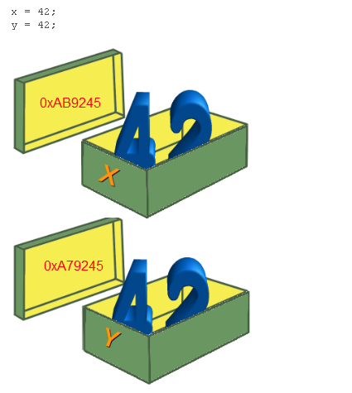
Python - Assignment Statements
Memory address

Slide 35
Python - Strings
Python accepts single ('), double (") and triple (''' or """) quotes to denote string literals, as long as the same type of quote starts and ends the string.
The triple quotes are used to span the string across multiple lines.
word = 'word'
sentence = "This is a sentence."
paragraph = """This is a paragraph. It is made up of multiple lines and sentences."""

Slide 36
Python - Comments
Notes of explanation within a program
Typically explains the purpose of that line
Ignored by Python interpreter
A hash sign (#) that is not inside a string literal begins a comment.
All characters after the # and up to the end of the physical line are part of the comment
Intended for a person reading the program’s code
End-line comment appears at the end of a line of code
# First comment
print "Hello, Python!" # second comment

Slide 37
Python - Multiple Assignments
Python allows to assign a single value to several variables at the same time.
a = b = c = 1

Slide 38
Python - Multiple Statements on a Single Line
The semicolon ( ; ) allows multiple statements on the single line given that neither statement starts a new code block
# First comment
x = 5; y = 12
print(x + y)

Slide 39
Python – Lines/Indentation
Python provides no braces to indicate blocks of code for class and function definitions or flow control.
The number of spaces in the indentation is variable, but all statements within the block must be indented the same amount
Blocks of code are denoted by line indentation, which is rigidly enforced.
if True:
print "Answer"
print "True"
else:
print "Answer"
print "False"

Slide 40
Python - Multi-Line Statements
Statements in Python typically end with a new line.
Python does, however, allow the use of the line continuation character (\) to denote that the line should continue.
Statements contained within the [], {}, or () brackets do not need to use the line continuation character.
total = itemOne + \
itemTwo + \
itemThree

Slide 41
Python – Suites/Blocks
A group of individual statements, which make a single code block are called suites in Python.
Header lines begin the statement (with the keyword) and terminate with a colon ( : ) and are followed by one or more lines which make up the suite.
Compound or complex statements, such as if, while, def, and class require a header line and a suite.
if expression :
suite
elif expression :
suite
else :
suite

Slide 42
Python – Data Types
The data types define the storage method for each of them.
Numbers
String
List
Tuple
Dictionary

Slide 43
Python – Numbers
Number data types store numeric values.
  varOne = 1
  varTwo = 10
Delete a single object or multiple objects by using the del statement.
  del varOne
  del varOne, varTwo

Slide 44
Python – Strings
Set of characters represented between quotation marks.
Allow for either pairs of single or double quotes.
myName = “My name is AllyBaba”
myName = ‘My name is AllyBaba’
print (myName) # Prints complete string

Slide 45
Python – Lists
Versatile compound data types.
A list contains items separated by commas and enclosed within square brackets [].
To some extent, lists are similar to arrays in C.
One difference between them is that all the items belonging to a list can be of different data type
list = [ 'abcd', 786 , 2.23, 'john', 70.2 ]
tinyList = [123, 'john']
print (tinyList) # Prints complete list

Slide 46
Python – Tuples
A tuple is similar to the list.
A tuple are set of values separated by commas.
Tuples are enclosed within parentheses ().
Lists are enclosed in brackets [ ] and are mutable, while tuples are enclosed in parentheses ( ) and are immutable. Tuples are read-only lists.
tuple = ( 'abcd', 786 , 2.23, 'john', 70.2 )
tinyTuple = (123, 'john')
print (tinyTuple) # Prints complete list

Slide 47
Python – Dictionary
Consist of key-value pairs.
A dictionary key can be almost any Python type, but are usually numbers or strings.
Values, on the other hand, can be any arbitrary Python object.
Dictionaries are enclosed by braces { } and values can be assigned and accessed using brackets [].
tinyDict = {'name': 'john','code':6734, 'dept': 'sales'}
print (tinyDict[‘name'] ) # Prints value for 'one' key

Slide 48
Python – Data Type Conversion
Conversions between built-in types
Function | Description
str(x) | Converts object x to a string representation.
tuple(s) | Converts s to a tuple.
list(s) | Converts s to a list.
chr(x) | Converts an integer to a character.
ord(x) | Converts a single character to its integer value.

Slide 49
Python – Mixed-Type Expressions
Data type resulting from math operation depends on data types of operands
Two int values: result is an int
Two float values: result is a float
int and float: int temporarily converted to float, result of the operation is a float
Type conversion of float to int causes truncation of fractional part

Slide 50
Python – Operators
Arithmetic Operators
Comparison (Relational) Operators
Assignment Operators
Logical Operators
Membership Operators
Identity Operators

Slide 51
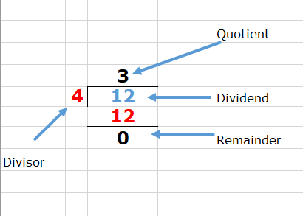
Python – Division
TRUE DIVISION (/)
12 / 4 = 3.0
FLOOR DIVISION (//)
12 // 4 = 3
Is the Quotient
MODULUS(%)
12 % 4 = 0
Is the Remainder

Slide 52
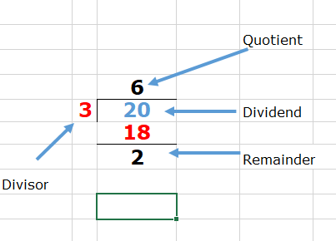
Python – Division
TRUE DIVISION (/)
20 / 3 = 6.666667
FLOOR DIVISION (//)
20 // 3 = 6
MODULUS(%)
20 % 3 = 2

Slide 53
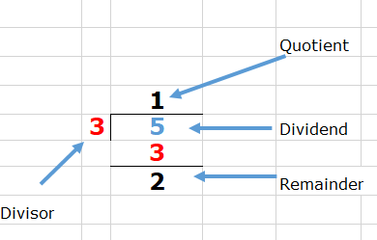
Python – Division
Practice
5 // 3 = ?
5 % 3 = ?
5 // 3 = 1
5 % 3 = 2

Slide 54
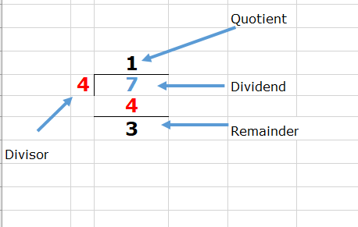
Python – Division
Practice
7 // 4 = ?
7 % 4 = ?
7 // 4 = 1
7 % 4 = 3

Slide 55
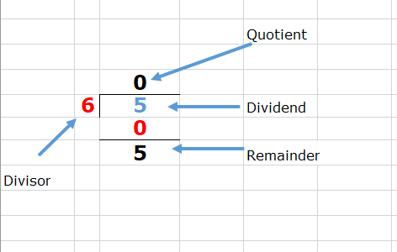
Python – Division
Practice
5 // 6 = ?
5 % 6 = ?
5 // 6 = 0
5 % 6 = 5

Slide 56
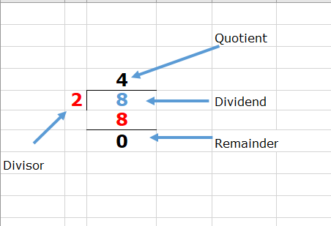
Python – Division
Practice – Even or Odd Number
Is 8 an EVEN number?
8 % 2 = 0
It is EVEN

Slide 57
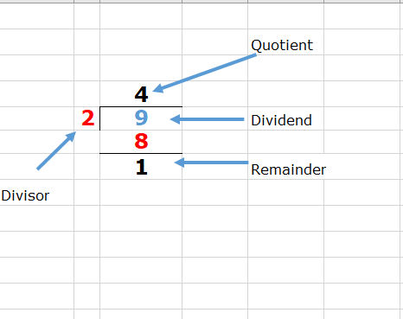
Python – Division
Practice – Even or Odd Number
Is 9 an ODD number?
9 % 2 =1
It is ODD

Slide 58
Python – Arithmetic Operators
  a = 10; b= 20
Operator | Description | Example
+ Addition | Adds values on either side of the operator. | a + b = 30
- Subtraction | Subtracts right hand operand from left hand operand. | a – b = -10
* Multiplication | Multiplies values on either side of the operator | a * b = 200
/ Division | Divides left hand operand by right hand operand | b / a = 2
% Modulus | Divides left hand operand by right hand operand and returns remainder | b % a = 0
** Exponent | Performs exponential (power) calculation on operators | a**b =10 to the power 20
// | Floor Division The division of operands where the result is the quotient in which the digits after the decimal point are removed. But if one of the operands is negative, the result is floored, i.e., rounded away from zero (towards negative infinity): | 9//2 = 4 and 9.0//2.0 = 4.0 -11//3 = -4 -11.0//3 = -4.0

Slide 59
Python – Comparison Operators
  a = 10; b = 20
Operator | Description | Example
== | If the values of two operands are equal, then the condition becomes true. | (a == b) is not true.
!= | If values of two operands are not equal, then condition becomes true. | (a != b) is true.
> | If the value of left operand is greater than the value of right operand, then condition becomes true. | (a > b) is not true.
< | If the value of left operand is less than the value of right operand, then condition becomes true. | (a < b) is true.
>= | If the value of left operand is greater than or equal to the value of right operand, then condition becomes true. | (a >= b) is not true.
<= | If the value of left operand is less than or equal to the value of right operand, then condition becomes true. | (a <= b) is true.

Slide 60
Python – Assignment Operators
  a = 10; b = 20
Operator | Description | Example
= | Assigns values from right side operands to left side operand | c = a + b assigns value of a + b into c
+= Add | It adds right operand to the left operand and assign the result to left operand | c += a is equivalent to c = c + a
-= Subtract | It subtracts right operand from the left operand and assign the result to left operand | c -= a is equivalent to c = c - a
*= Multiply | It multiplies right operand with the left operand and assign the result to left operand | c *= a is equivalent to c = c * a
/= Divide | It divides left operand with the right operand and assign the result to left operand | c /= a is equivalent to c = c / a
%= Modulus | It takes modulus using two operands and assign the result to left operand | c %= a is equivalent to c = c % a
**= Exponent | Performs exponential (power) calculation on operators and assign value to the left operand | c **= a is equivalent to c = c ** a
//= Floor Division | It performs floor division on operators and assign value to the left operand | c //= a is equivalent to c = c // a

Slide 61


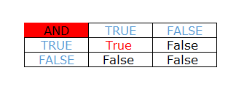
Python – Logical Operators
  AND

Slide 62
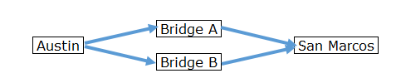
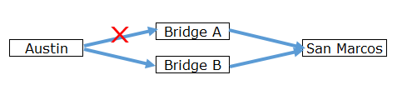
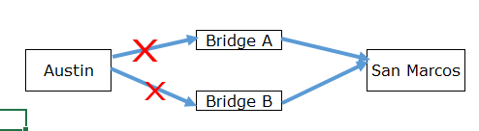

Python – Logical Operators
  OR

Slide 63
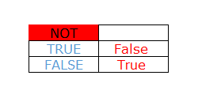
Python – Logical Operators
  NOT

Slide 64
Python – Logical Operators
  a =true ; b = false
Operator | Description | Example
Logical AND | If both the operands are true then condition becomes true. | a and b is false.
Logical OR | If any of the two operands are non-zero then condition becomes true. | a or b is true.
Logical NOT | Used to reverse the logical state of its operand. | Not(a and b) is true.

Slide 65
Python – Membership Operators
Operator | Description | Example
in | Evaluates to true if it finds a variable in the specified sequence and false otherwise. | x = [1, 2, 3] Is 1 in x? True
not in | Evaluates to true if it does not finds a variable in the specified sequence and false otherwise. | x = [1, 2, 3] Is 1 not in x? False

Slide 66
Python – Identity Operators
Operator | Description | Example
is | Evaluates to true if the variables on either side of the operator point to the same object and false otherwise. | x = [1, 2, 3] y = x Is x is y? True
is not | Evaluates to false if the variables on either side of the operator point to the same object and true otherwise. | x = [1, 2, 3] y = x Is x is not y? False

Slide 67
Python – Operators Precedence
Operator | Description
** | Exponentiation (raise to the power)
~ + - | Complement, unary plus and minus
* / % // | Multiply, divide, modulo and floor division
+ - | Addition and subtraction
<= < > >= | Comparison operators
<> == != | Equality operators
= %= /= //= -= += *= **= | Assignment operators
is - is not | Identity operators
in - not in | Membership operators
not or and | Logical operators

Slide 68
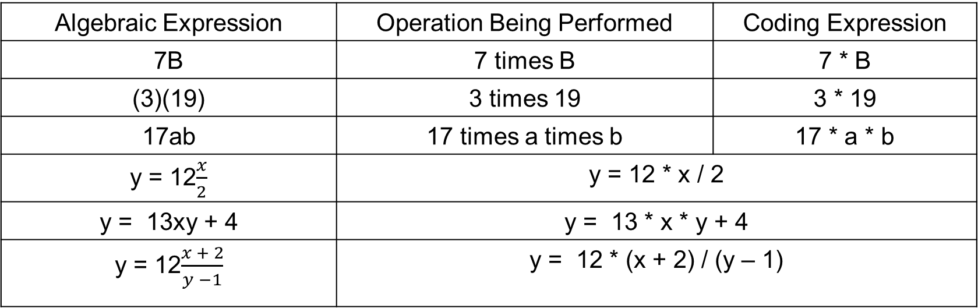
Arithmetic Expression to Coding
Algebraic Expression | Operation Being Performed | Coding Expression
7B | 7 times B | 7 * B
(3)(19) | 3 times 19 | 3 * 19
17ab | 17 times a times b | 17 * a * b
y = 12$\frac{x}{2}$ | y = 12 * x / 2
y = 13xy + 4 | y = 13 * x * y + 4
y = 12$\frac{x + 2}{y −1}$ | y = 12 * (x + 2) / (y – 1)

Slide 69
Arithmetic Expression to Coding
Algebraic Expression
2a + 4ab + 5a(b + c)
Coding Expression
2 * a + 4 * a * b + 5 * a * (b + c)

Slide 70
Arithmetic Expression to Coding
Algebraic Expression
(x + 2)(y + z)
Coding Expression
(x + 2) * (y + z)

Slide 71
Arithmetic Expression to Coding
Algebraic Expression
(x − 2)(x + 2) 8x
Coding Expression
( x – 2) * (x + 2) / (8 * x)

Slide 72
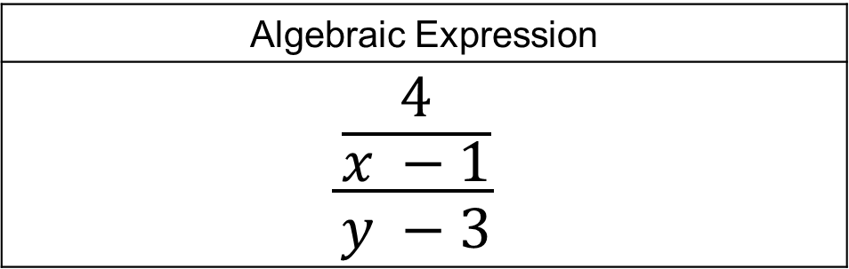
Arithmetic Expression to Coding
Algebraic Expression
$$\frac{\frac{4}{x −1}}{y −3}$$
Coding Expression
4 / (x – 1) / (y – 3)

Slide 73
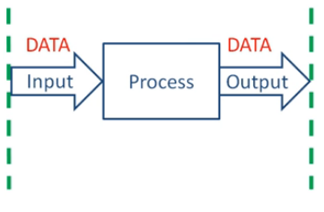
Python – IPO
input
Assignment =
Arithmetic
Logical
print

Slide 74
Python – print Function
Function
print function
Argument
Example: data that is printed to screen
Statements in a program execute in the order that they appear
From top to bottom
piece of prewritten code that performs an operation
displays output on the screen
data given to a function
Python allows one to display multiple items with a single call to print
Items are separated by commas when passed as arguments
Arguments displayed in the order they are passed to the print function
Items are automatically separated by a space when displayed on screen

Slide 75
Python – print Function
Most programs need to read input from the user
Special characters in string literal
  Preceded by backslash (\)
    newline (\n), horizontal tab (\t)
  Treated as commands embedded in string
+ operator used in string concatenation
  Useful for breaking up a long string

Slide 76
Python – input Function
Most programs need to read input from the user
Format: variable = input(prompt)
  prompt is typically a string instructing user to enter a value
Does not automatically display a space after the prompt
input function always returns a string

Slide 77
Python – Examples
1 | print(‘Ally Baba’)
2 | print(‘123 Scooby Dooby Lane’)
3 | print(‘Ally Baba City, AA 23456’)
Output | Ally Baba
 | 123 Scooby Dooby Lane
 | Ally Baba City, AA 23456

Slide 78
Python – Examples
1 | print("Don't fear!")
2 | print("I'm here!")
3 | print('Your assignment is to read "AllyBaba" by tomorrow.')
Output | Don't fear! I'm here! Your assignment is to read "AllyBaba" by tomorrow.

Slide 79
Python – Examples
1 | # This program demonstrates a variable
2 | myIncome = 1000
3
4 | # This section prints the variable in 2 lines
5 | print('My income is')
6 | print(myIncome)
Output | My income is 1000

Slide 80
Python – Examples
1 | # This program demonstrates a variable
2 | myIncome = 1000
3
4 | # This section prints the variable in 1 line
5 | print('My income is ', myIncome)
Output | My income is 1000

Slide 81
Python – Examples
1 | # Input section
2 | myIncome = input('Please enter your income ')
3
4 | # print section
5 | print('My income is ', myIncome)
Screen Display | Please enter your income 1000 (data entered by user) My income is 1000

Slide 82
Python – Examples
1 | # Assignment section
2 | valueOne = 12
3 | valueTwo = 13
4
5 | # Calculation section
6 | result = valueOne + valueTwo
7
8 | # print section
9 | print('My total is ', result)
Screen Display | My total is 25

Slide 83
Python – Examples
1 | # Input section
2 | valueOne = int(input('Enter value one '))
3 | valueTwo = int(input('Enter value two '))
4
5 | # Calculation section
6 | result = valueOne + valueTwo
7
8 | # print section
9 | print('My total is ', result)
Screen Display | Enter value one 12 (data entered by user) Enter value two 13 (data entered by user) My total is 25

Slide 84
Python – Examples
1 | # Input section
2 | salary = float(input('Enter salary '))
3 | bonus = float(input('Enter bonus '))
4
5 | # Calculation section
6 | pay = salary + bonus
7
8 | # print section
9 | print('My total pay is ', pay)
Screen Display | Enter salary 1000 (data entered by user) Enter bonus 200 (data entered by user) My total pay is 1200.0

Slide 85
Python – Examples
1 | # Input section
2 | lastName = input('Enter last name ')
3 | firstName = input('Enter first name ')
4
5 | # print section
6 | print('Welcome ', lastName, firstName)
Screen Display | Enter last name ally Enter first name baba Welcome ally baba

Slide 86
Python – Examples
Computing Weekly Pay

Slide 87
Python – Computing Weekly Pay
1 | # Input section
2 | hoursWorked = float(input('Enter hours worked '))
3 | hourlyPayRate = float(input('Enter hourly pay rate '))
4
5 | # calculate weekly pay
6 | grossPay = hoursWorked * hourlyPayRate
7
8 | # print pay
9 | print('My total pay is ', grossPay)
Screen Display | Enter hours worked 20 Enter hourly pay rate 10 My total pay is 200.0

Slide 88
Python – Computing Weekly Pay
1 | # Input section
2 | hoursWorked = float(input('Enter hours worked '))
3 | hourlyPayRate = float(input('Enter hourly pay rate '))
4
5 | # calculate weekly pay
6 | grossPay = hoursWorked * hourlyPayRate
7
8 | # print pay
9 | print('My total pay is ', format(grossPay, '7.2f'))
Screen Display | Enter hours worked 20 Enter hourly pay rate 10 My total pay is 200.00

Slide 89
Python – Tracing the flow
Tracing the code
# | valueOne | valueTwo | result | Output
1
2
3
4
5
6
7
8
9
1 | # Assignment section
2 | valueOne = 12
3 | valueTwo = 13
4
5 | # Calculation section
6 | result = valueOne + valueTwo
7
8 | # print section
9 | print('My total is ', result)
12
12
13
12
13
12
13
12
13
25
12
13
25
12
13
25
12
13
25
25

Slide 90
Python – Tracing the flow
1 | # Input section
2 | hoursWorked = float(input('Enter hours worked '))
3 | hourlyPayRate = float(input('Enter hourly pay rate '))
4
5 | # calculate weekly pay
6 | grossPay = hoursWorked * hourlyPayRate
7
8 | # print pay
9 | print('My total pay is ', grossPay)
Behind the scene
# | hoursWorked | hourlyPayRate | grossPay
1
2
3
4
5
6
7
8
9
20
20
10
20
10
20
10
20
10
200
20
10
200
Screen Display
10
20
200
@2 - Enter hours worked
20
20
10
200
@2 - Enter hourly pay rate
10
@9 - My total pay is 200.0

